Slide 1
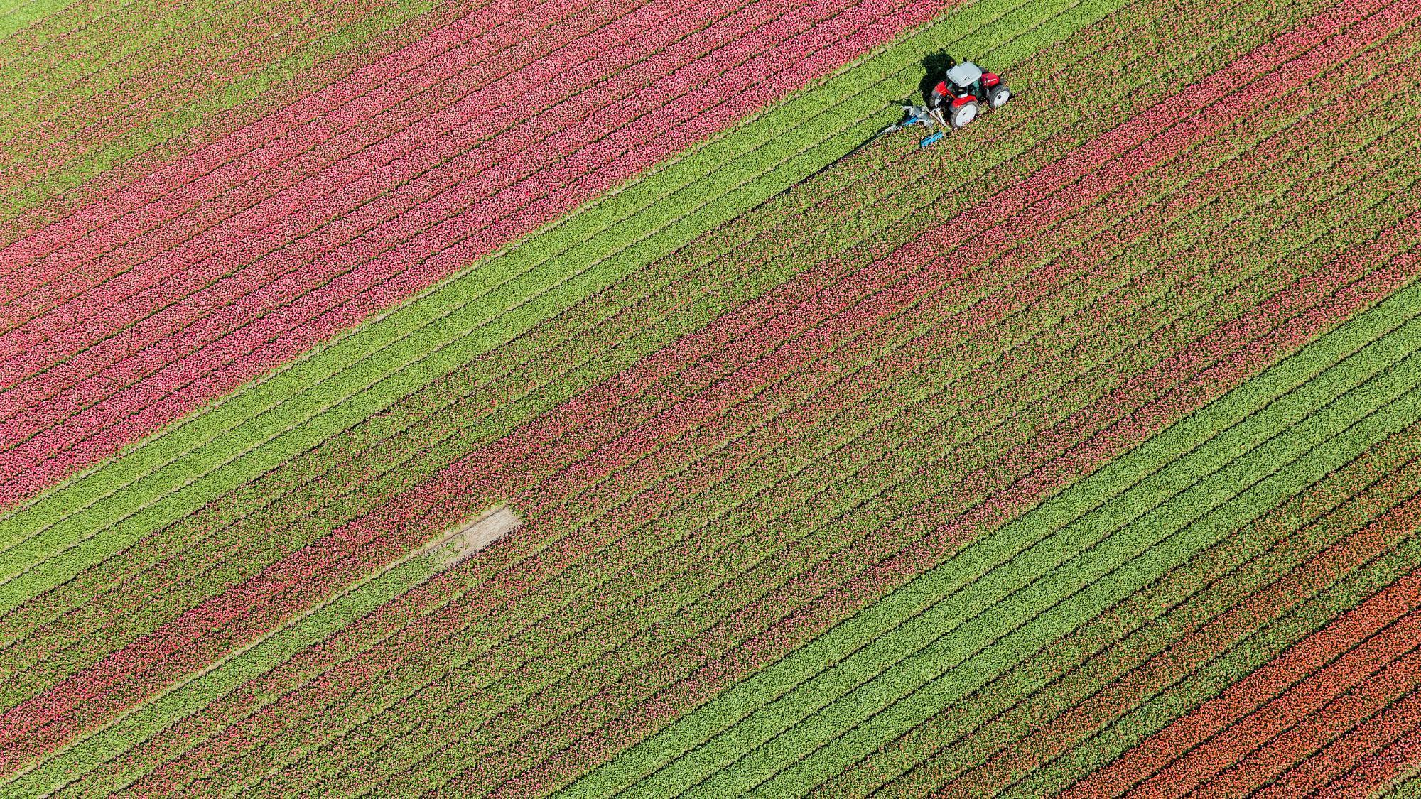
farmConnect
Team Yarr

Slide 2
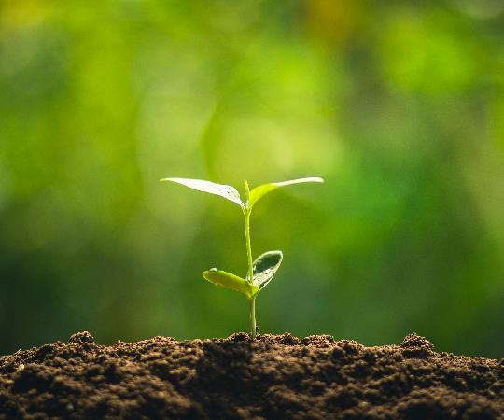
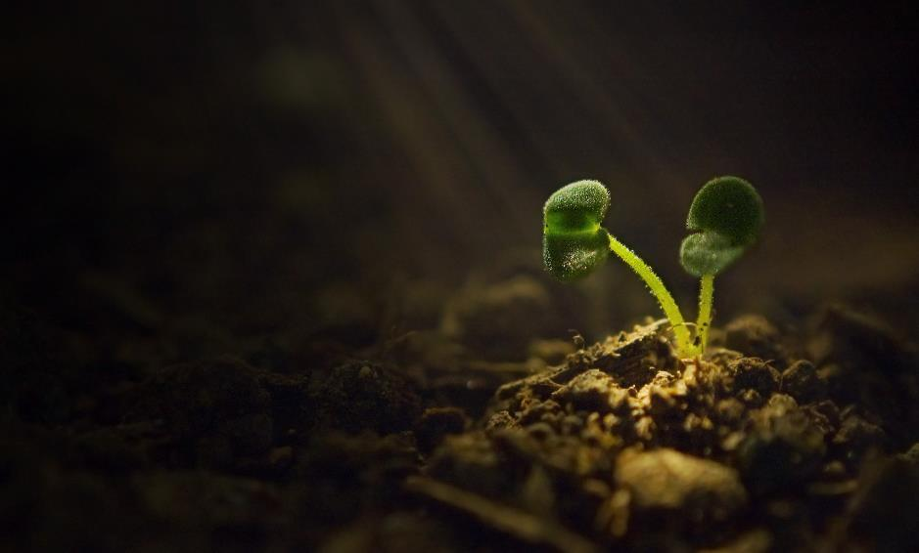
Team Yarr
Rajat Paliwal
Saurabh Saini
Swastik Kulshreshtha
Utkarsh Tailor

Slide 3
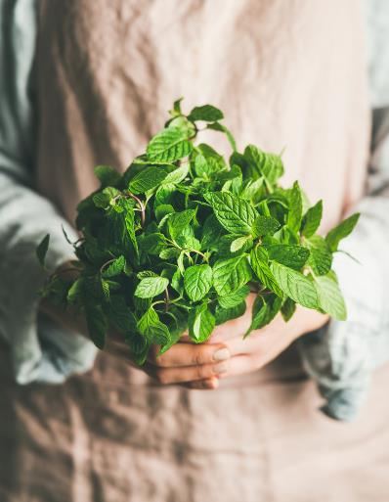
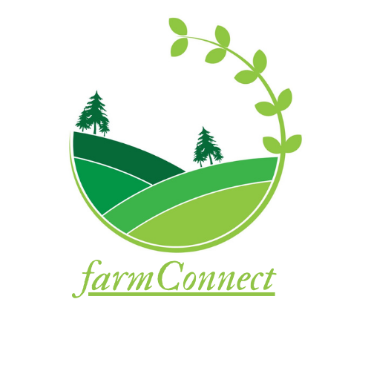
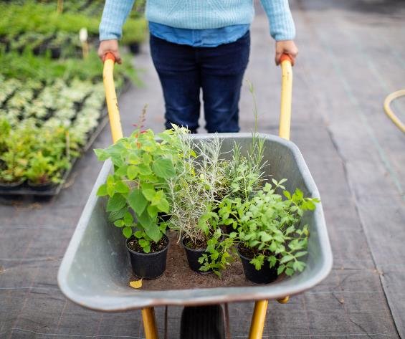
Introduction
A web platform to Connect farmers with consumers directly to facilitate the sale of fresh, locally grown produce that is free from middleman commission.

Slide 4
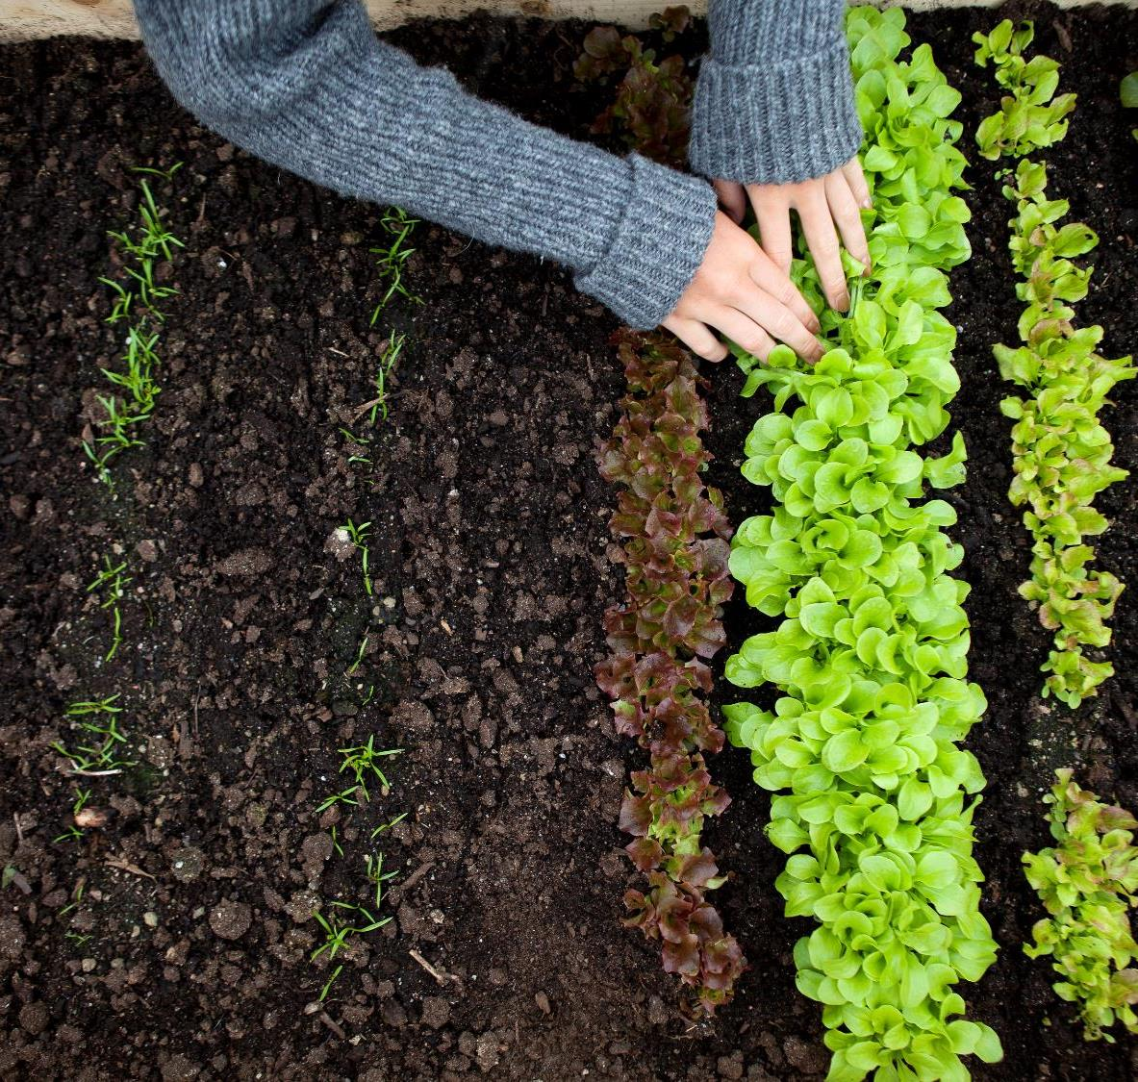
Farmers
Using farmConnect

Slide 5
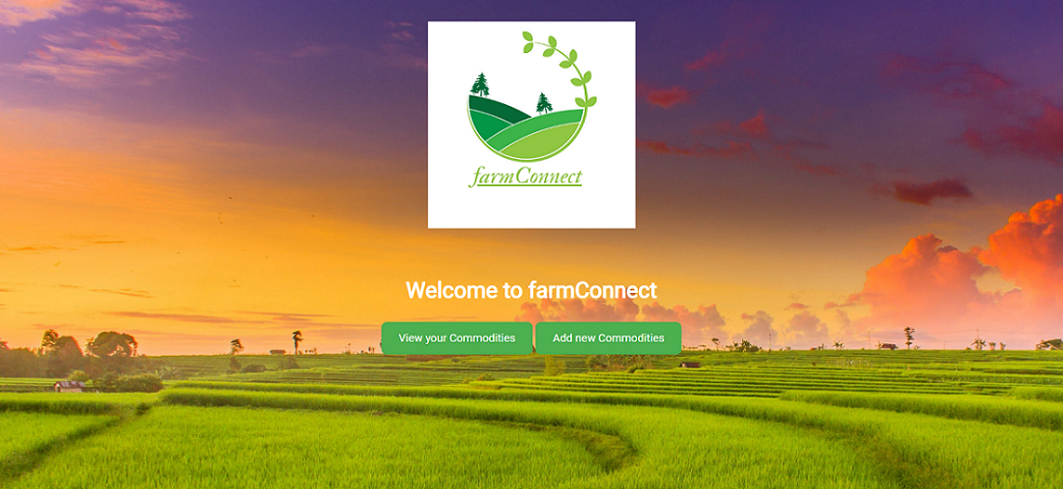


Slide 6
Consumers
Using farmConnect

Slide 7


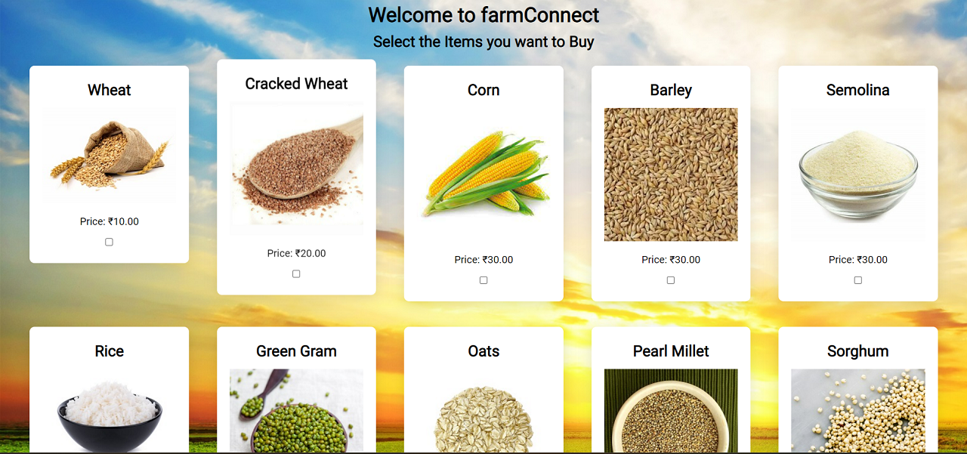

Slide 8
Development
of farmConnect

Slide 9
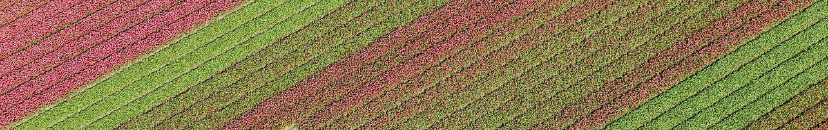
Timeline
Project Start
Back End
Creating the Back End Functionality of the Web Portal with Django
Learning Various Technologies like Django and HTML/CSS/JS
Front End
Understanding the relationship and connection between Front End and Back End
Creating the basic layout and file structure of the project.
Creating the Front End of the Web Portal with HTML/CSS/JS

Slide 10
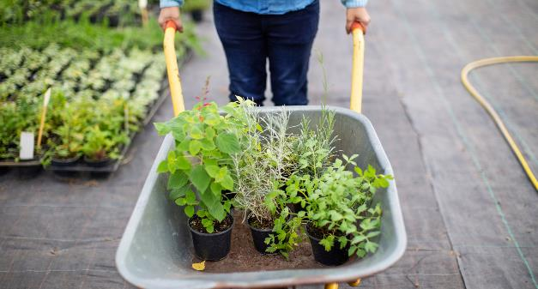
Basic Divisions
Front End
Backend
Add text, images, art, and videos.
Add transitions, animations, and motion.
Add functionality to the website.

Slide 11
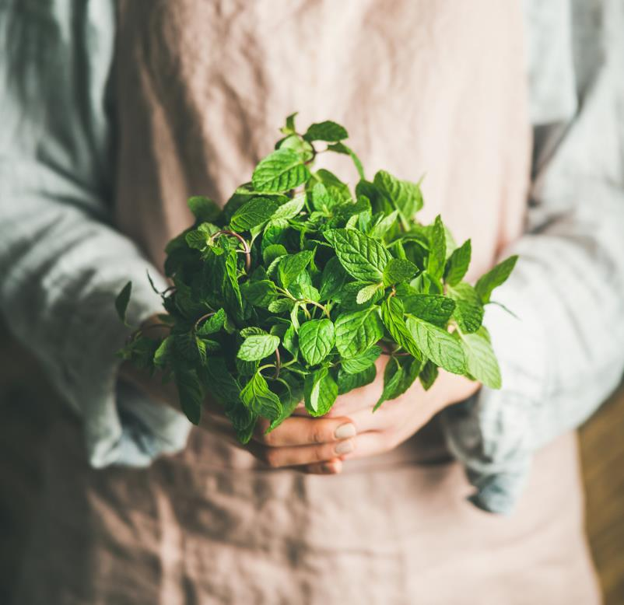
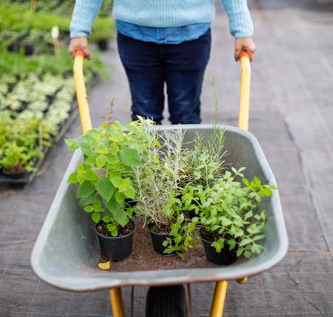
Summary
farmConnect is a web portal that uses HTML, CSS, JavaScript and Django to enable farmers to connect directly with consumers, bypassing middlemen, for more efficient and cost-effective transactions.

Slide 12
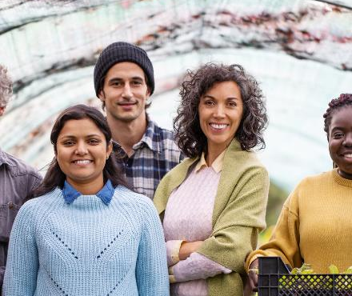
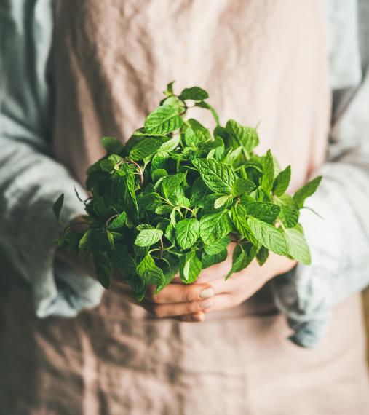
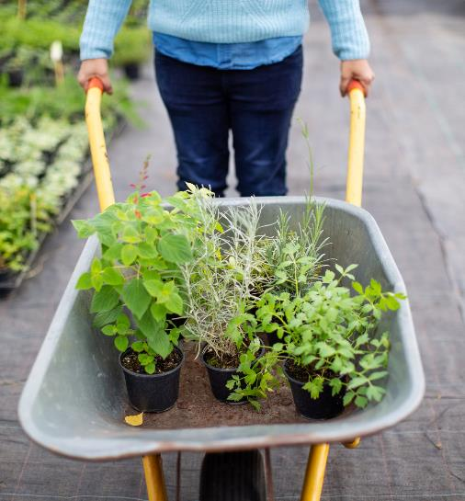
Thank You

